Slide 1
UNIT THREE – Part Two

Slide 2
Characteristics of Control
Managerial Function
Continuous Activity
Control is Related to Planning
Essence of Control is Action

Slide 3
Importance of Controlling
Accomplishing Organizational Goals
Judging Accuracy of Standards
Making Efficient use of Resources
Improving Employee Motivation
Ensuring Order & Discipline
Facilitating Coordination in Action

Slide 4
Motivation
Motivation and rewards
Extrinsic rewards are externally administered
Intrinsic rewards, on the other hand, are self-administered

Slide 5
Importance of Employee Motivation
Organization Goal Achievement
Enduring Relationship
Workforce Stability
Role of Human Resource
Reduction in Employees’ Turnover
The reinforcement theory of motivation focuses attention on the environment as a major source of rewards and influence on human behavior

Slide 6
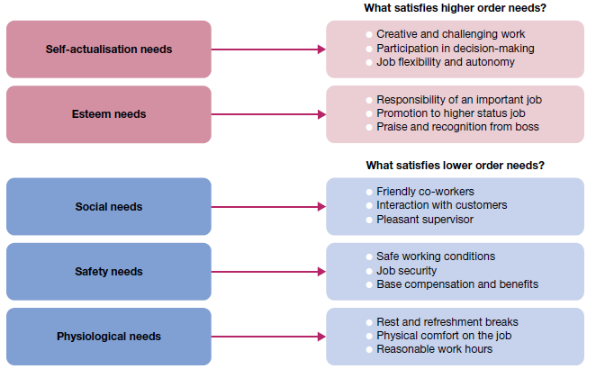
Hierarchy of needs theory
Opportunities for satisfaction in Maslow’s hierarchy of human needs

Slide 7
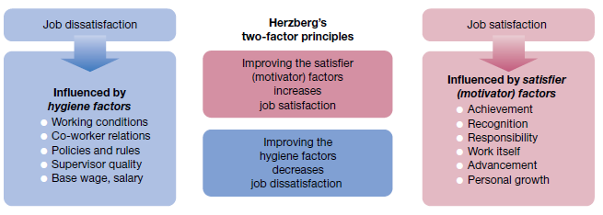
Herzberg’s Two-factor theory

Slide 8
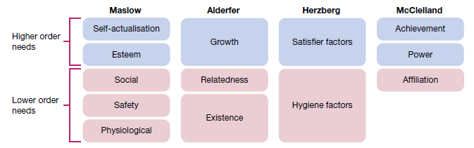
Comparison of Maslow’s, Alderfer’s, Herzberg’s and McClelland’s motivation theories

Slide 9
Theory X
Disfavor working.
Abstain responsibility and the need to be directed.
Need to be controlled, forced, and warned to deliver what's needed.
Demand to be supervised at each and every step, with controls put in place.
Require to be attracted to produce results, else they have no ambition or incentive to work.

Slide 10
Theory Y
Take responsibility willingly and are encouraged to fulfill the goals they are given.
Explore and accept responsibility and do not need much guidance.
Assume work as a natural part of life and solve work issues imaginatively.
In Y-type organizations, people at lower levels are engaged in decision making and have more responsibility.

Slide 11
Comparing Theory X & Theory Y
Motivation
Theory X considers that people dislike work, they want to avoid it and do not take responsibilities willingly.
While, Theory Y considers that people are self-motivated, and sportingly take responsibilities.
Management Style and Control
In Theory X-type organization, management is authoritarian, and centralized control is maintained.
While in Theory Y-type organization, the management style is participative, employees are involved decision making, but the power retains to implement decisions.
Work Organization
Theory X employees are specialized and the same work cycle continues.

Slide 12
In Theory Y, the work tends to be coordinated around wider areas of skill or knowledge. Employees are also motivated to develop expertise, and make suggestions and improvements.
Rewards and Appraisals
Theory X-type organizations work on a ‘carrot and stick’ basis, and performance assessment is part of the overall mechanism of control and compensation.
Coming to Theory Y-type organizations, appraisal is also regular and crucial, but is usually a separate mechanism from organizational controls. Theory Y-type organizations provide employees frequent opportunities for promotion.

